Slide 1
PRAGMA 13 DEMO:
Data Management at Kenting's Underwater Ecological Observatory: RBNB & SRB
NCHC, UCSD

Slide 2
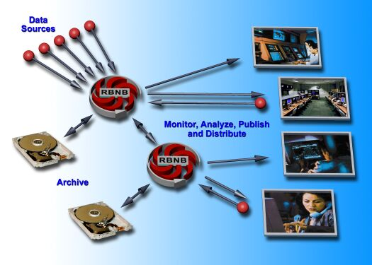
RBNB (Ring Buffer Network Bus)
-- real-time queuing and messaging system
-- general dynamic data Server
Source: rbnb.creare.com

Slide 3
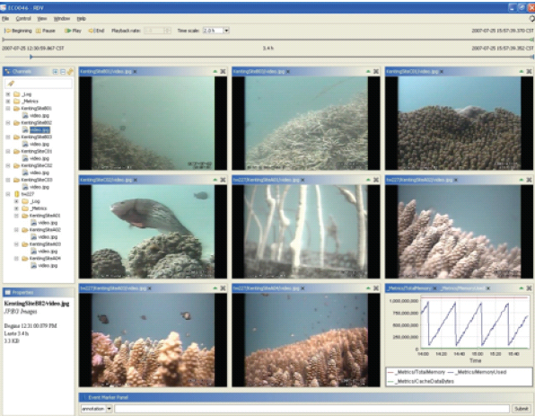
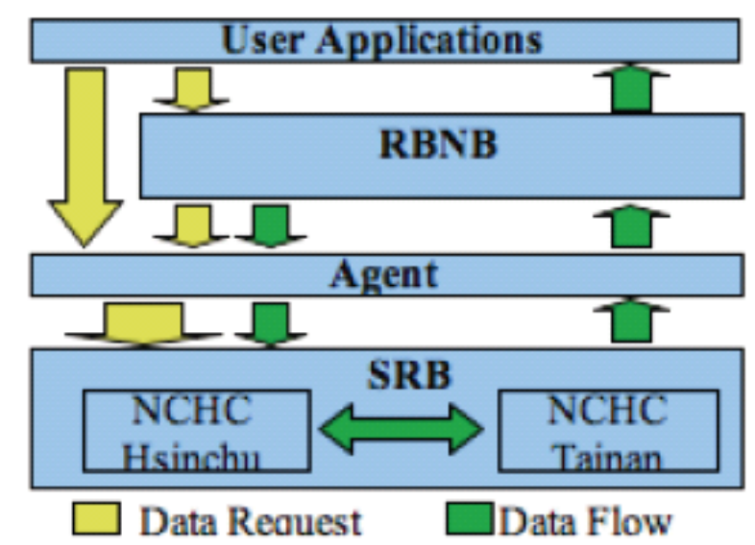
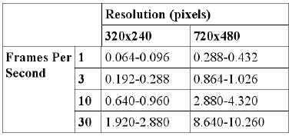
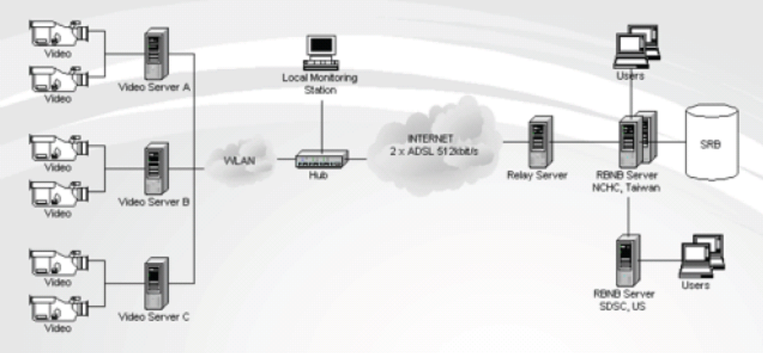
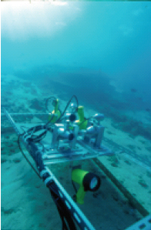
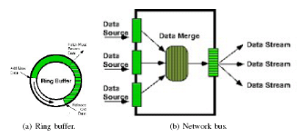
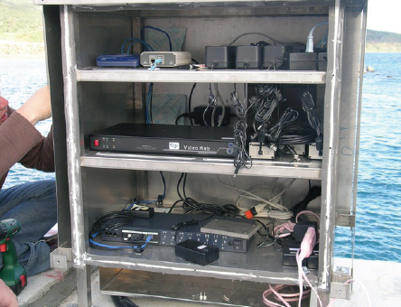

Slide 4
Scenario: Hierarchical Model for RBNB
Users
(RDV)
Eco046.nchc.org.tw:3333
Eco047
tw227
Flat files
Kenting Video Feed
Eco048
Eco040
Water Resource Agency Video Feed
SRB
Yuan-Yang Lake (YYL) Meteorological data feed
Oracle

Slide 5
Demo Procedure
Using RDV (Real-time data viewer) as RBNB interface
Retrieve data from Archives and connect to RBNB
  SRB (Temporary clips)
  ORACLE (YYL)
Show live streams and playback for
  KT and WRA video feed.
  YYL data feed.

